Slide 1
HACKATHON PROJECT
Group 5 : BUG HUNTERS
Group Members –
934175 SATYAM BHANU
934176 SNEH SPARSH
934192 KUSHAGRA AGRAWAL
935054 ISHUTOSH NARAYAN
935055 RITABRATA GHORAI
© 2021 Cognizant

Slide 2
Problem Statement : Identify Car Wash Services.
Display 5 Car washing services name and phone numbers
1. Car washing services near you with highest rating on top.
2. Rating should be more than 4*
3. Customer Votes should be more than 20
(Suggested Site: justdial.com)
Detailed Description:
1.Display 5 Car washing services name and phone numbers, near your location with highest rating (more than on top & Customer Votes more than 20.
2. Try to register for Free Listing, fill the form with any one input invalid (example: phone); Capture the error message & display
3. From Fitness, go to Gym and retrieve all sub-menu items and store in a List and Display the same.

Slide 3
APPROACH:
1.The hackathon problem statement that is given automated by selenium.
2. Language used for automation is Java.
3.Maven is used for architectural design and as a Dependency management Tool.
4.TestNG testing framework is used for Test Execution using TestNG annotation.
5.Extent Report is used for generate an HTML report on the user-specified path.
6.Test Design Technique used is POM and Data Driven using Excel.
7. For building, testing, and deploying, facilitating continuous integration and continuous delivery, Jenkins open source automation server is used.

Slide 4
Framework Structure:
1
Base Class
8
6
6
5
2
Jenkins
Extent Report
TestNG.XML
Test Cases
Page Objects
TestCarWash.java
3
Utilities
Test Data
4
7
Config.files
Report

Slide 5
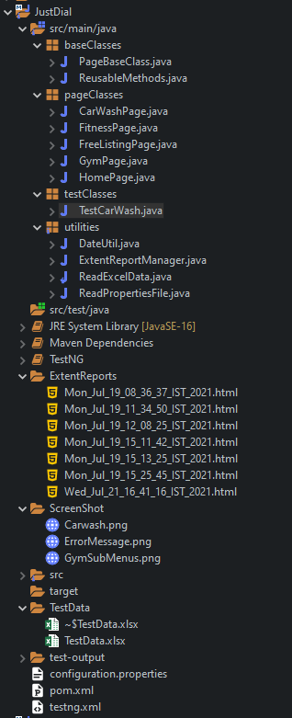
Base Class
Page Objects
Test classes
Utilities
Project Structure
Extent Report
Screenshots
Config.Files

Slide 6
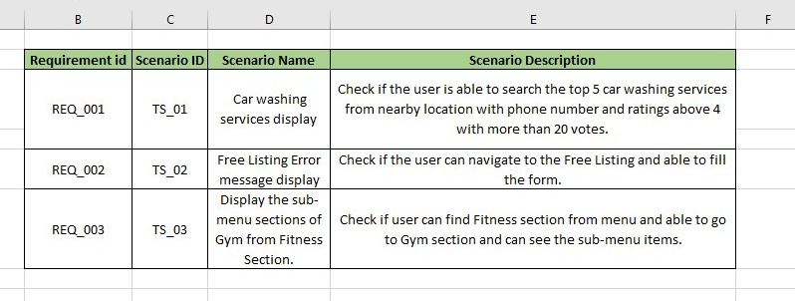
TEST SCENARIOS:

Slide 7
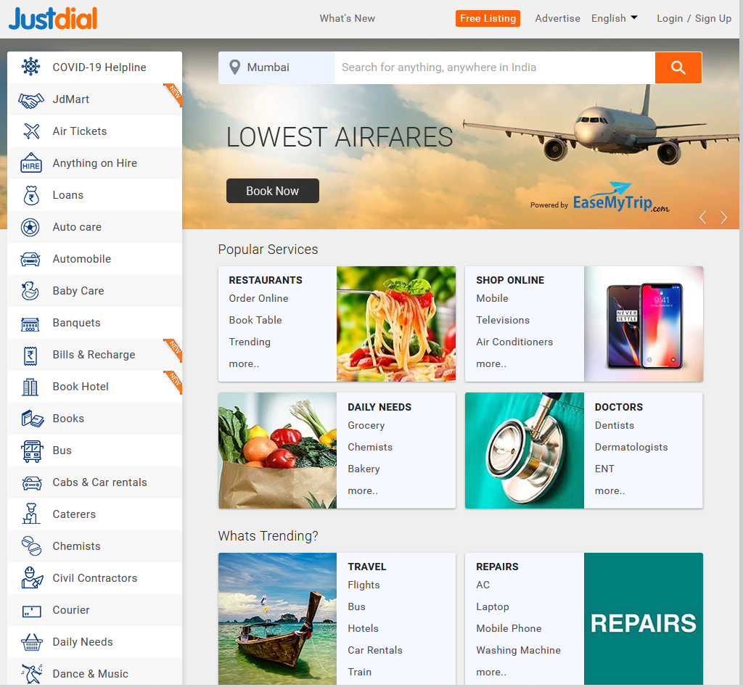
HOMEPAGE OF “https://www.justdial.com/”

Slide 8
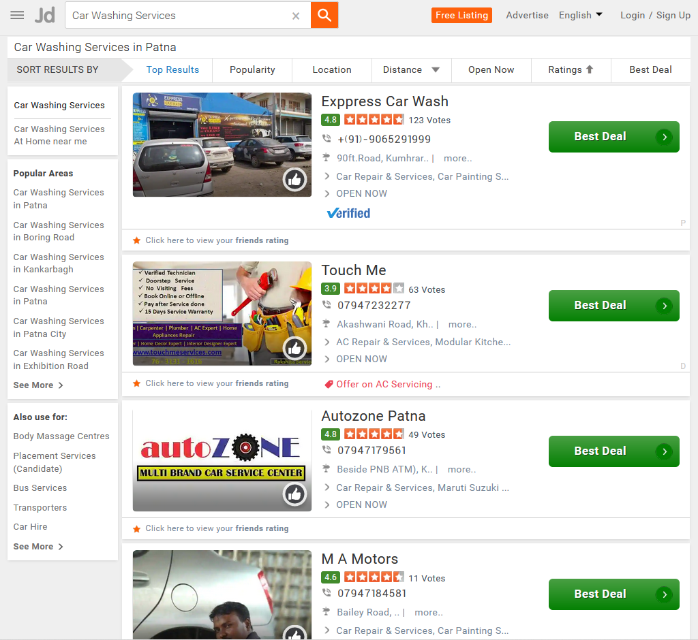
Scenario 1: Display 5 Car washing services name and phone numbers, near your location with highest rating (more than 4) on top & Customer Votes more than 20

Slide 9
Workflow:
1. Invoke Browser.
2. Launch the website: https://www.justdial.com/.
3. Select city.
4. Search for “Car Washing Services”.
5. Close the pop-up.
6.Extract the information of Car Washing Services that satisfies the given condition.
7.Extracted information is displayed on the console.
8.Navigate back to the Homepage.

Slide 10
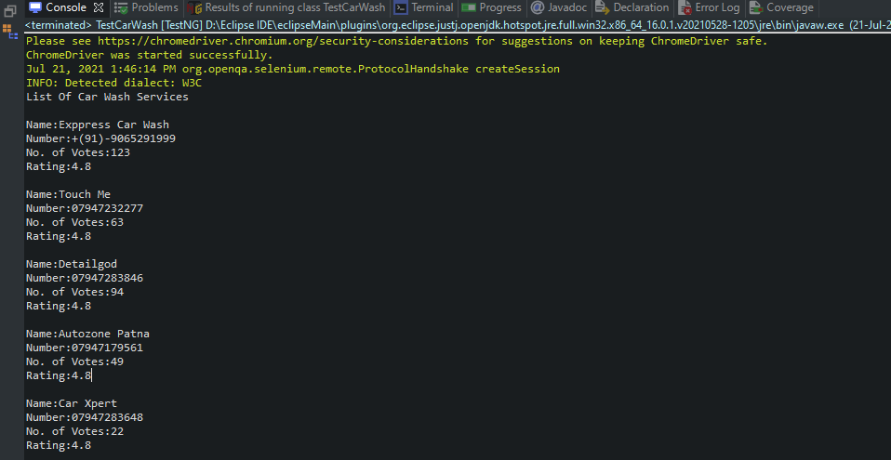
Extracting and displaying the Car washing services name and phone numbers, near your location with highest rating (more than 4) on top & Customer Votes more than 20.

Slide 11
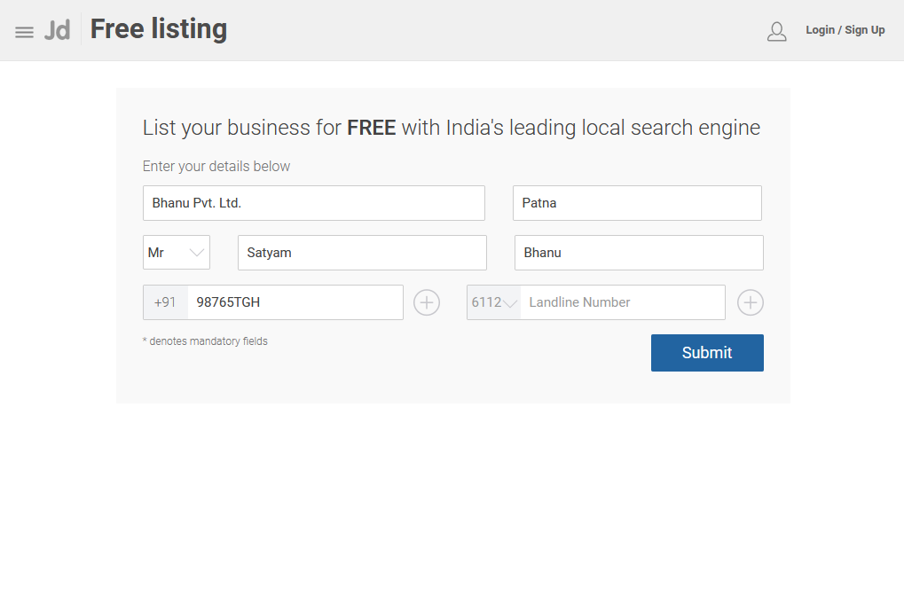
Scenario 2: Try to register for Free Listing, fill the form with any one input invalid (example: phone); Capture the error message & display

Slide 12
Workflow:
1.Click on Free Listing from the Homepage.
2.All the details in Free Listing Form will be given by a excel as we are using data driven approach with any one input invalid such as invalid mobile number to capture the error message.
3.Click on “Submit” .
4.Error message will be captured and displayed in the console.
5.Navigate back to Homepage.

Slide 13
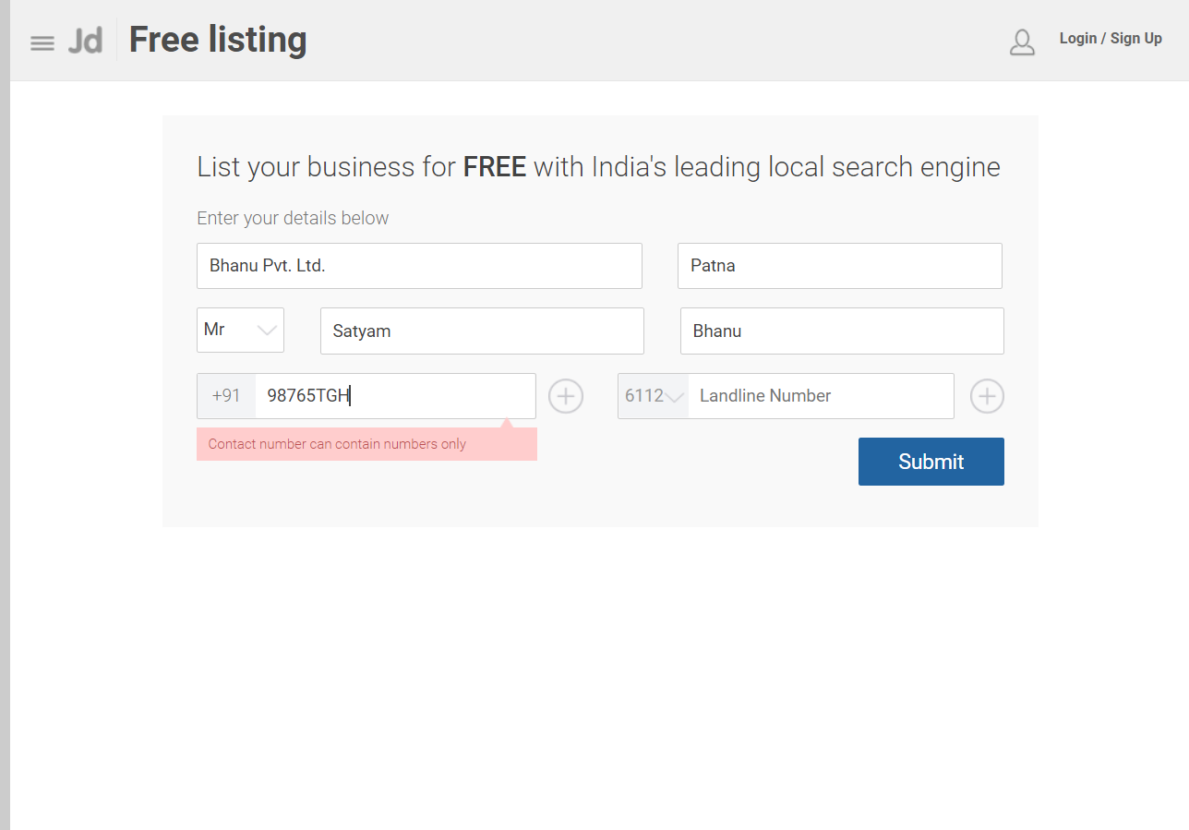

Capturing and displaying the error message in console.

Slide 14
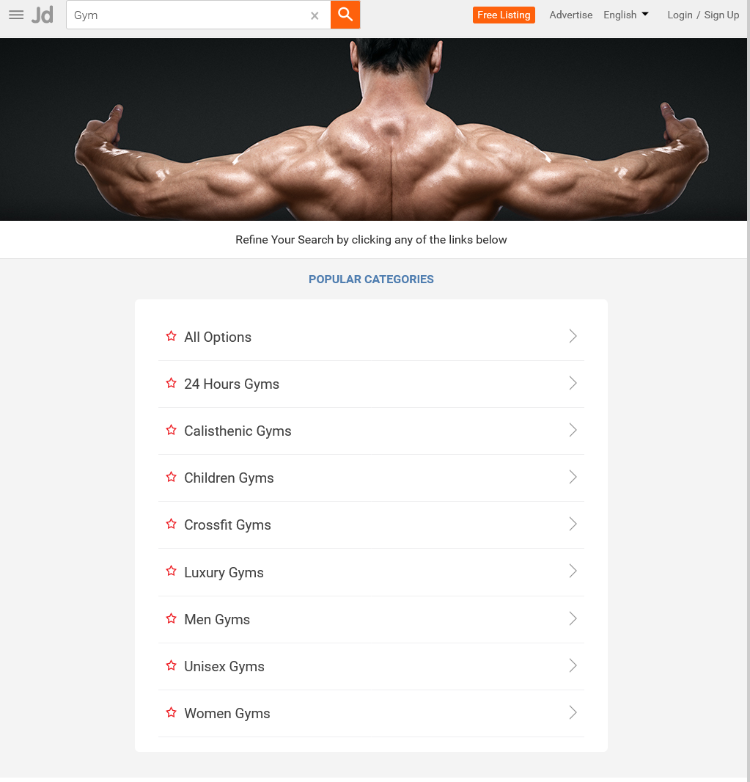
Scenario 3: From Fitness, go to Gym and retrieve all sub-menu items and store in a List; Display the same

Slide 15
Workflow:
1.Scoll down in Homepage.
2.Click on Fitness Tab.
3.Click on Gym Tab in sub-menu of Fitness.
4.Extract all the sub-menu of Gym tab and Display in the console.
5.Browser will be closed.

Slide 16
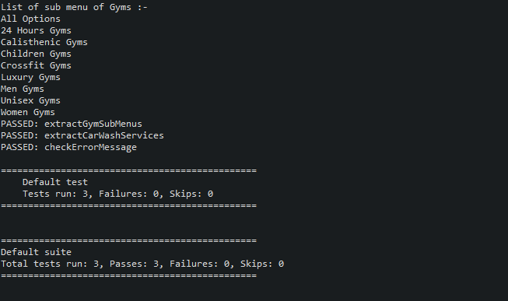
Extracting and displaying the sub-menu items of Gym.

Slide 17
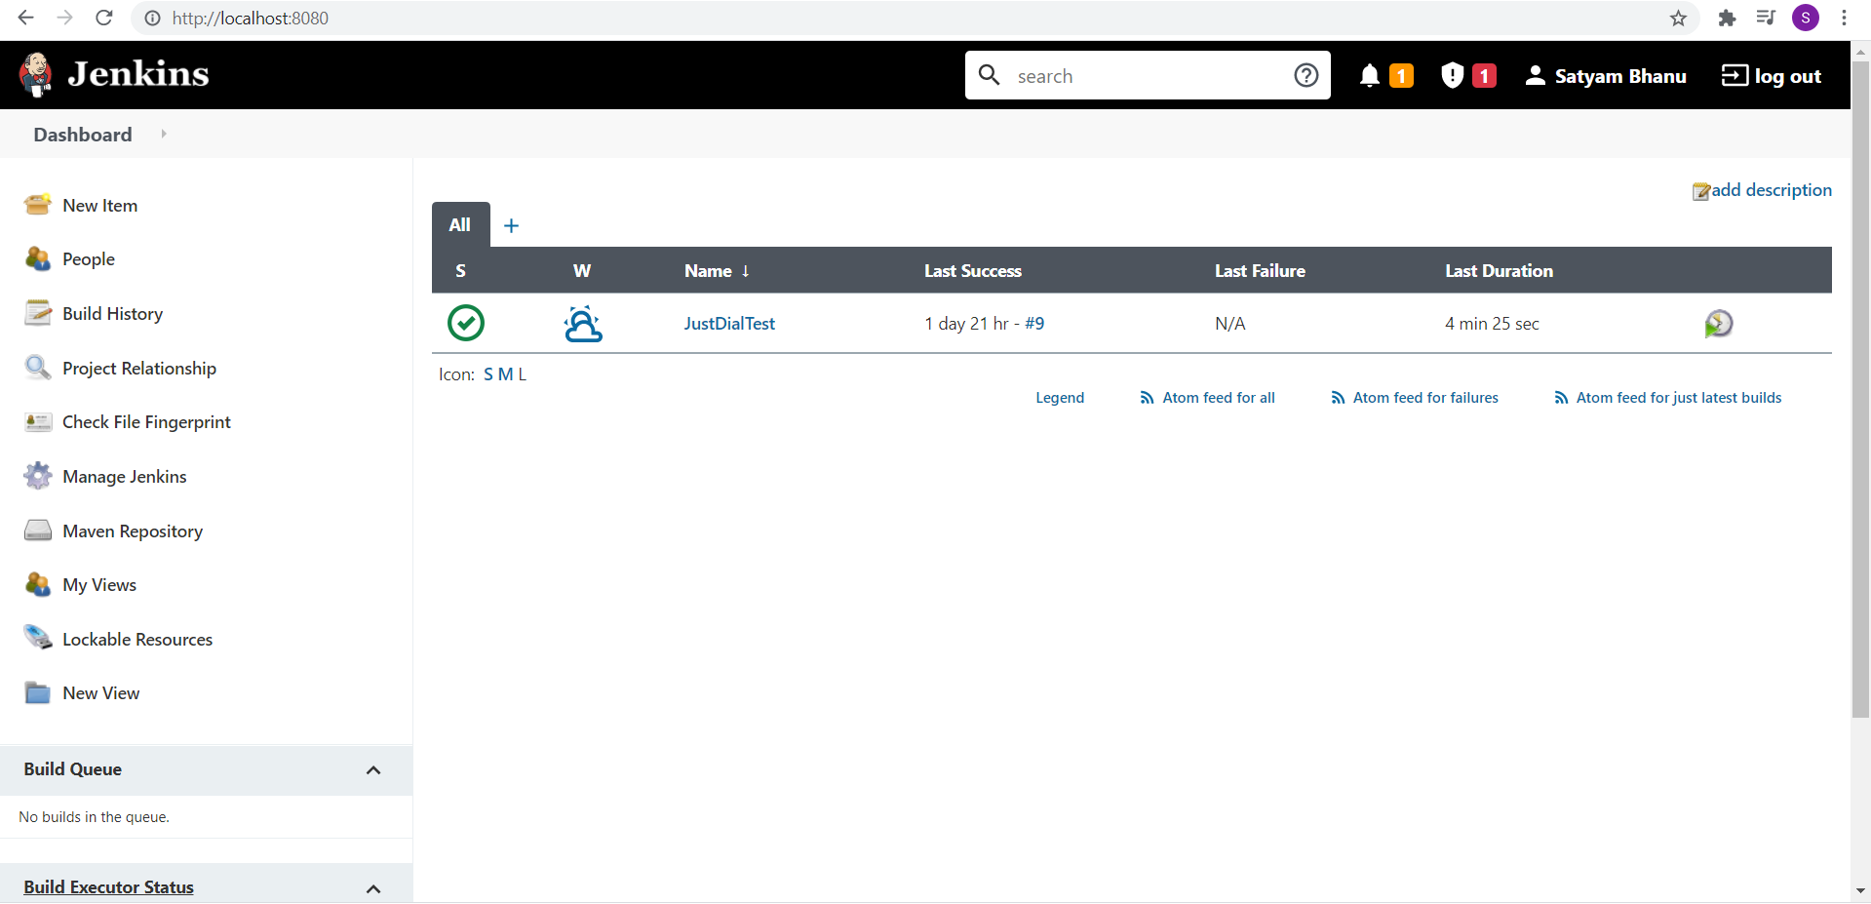
Jenkins Implementation:

Slide 18
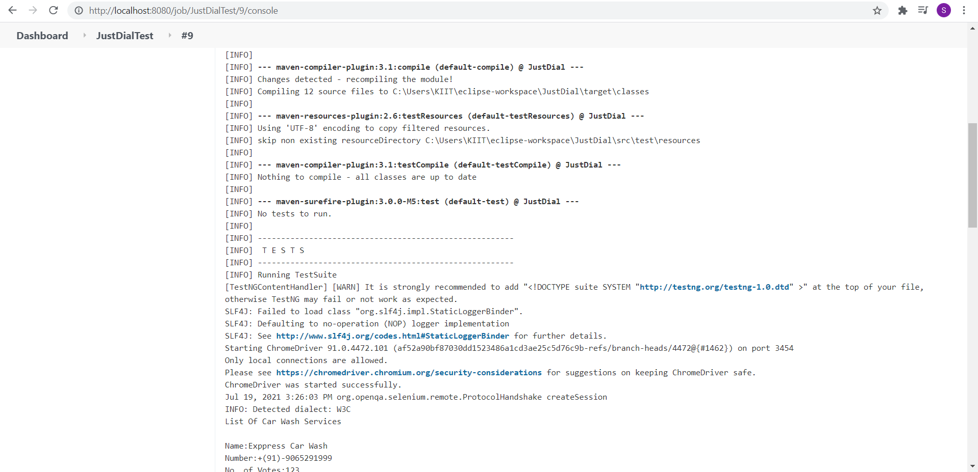

Slide 19
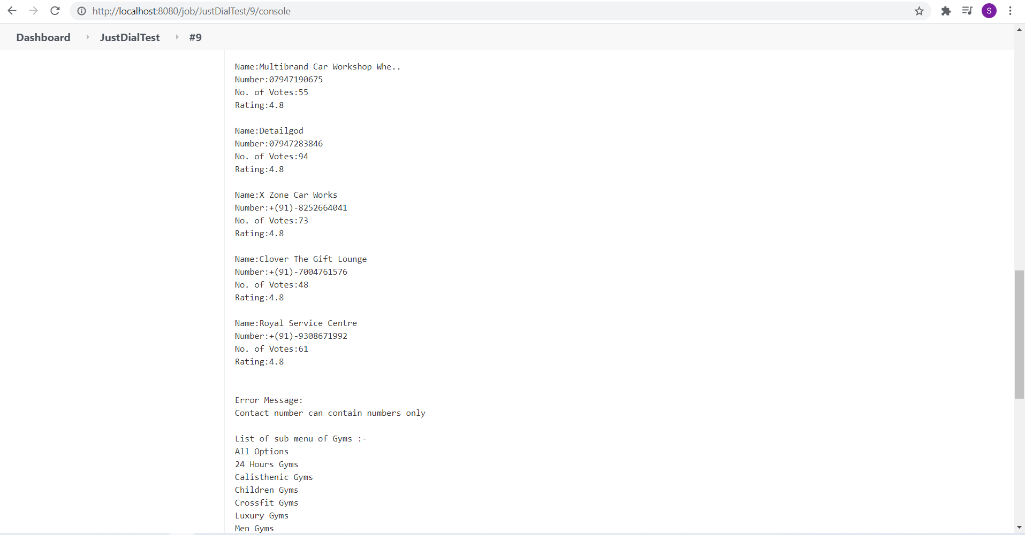

Slide 20
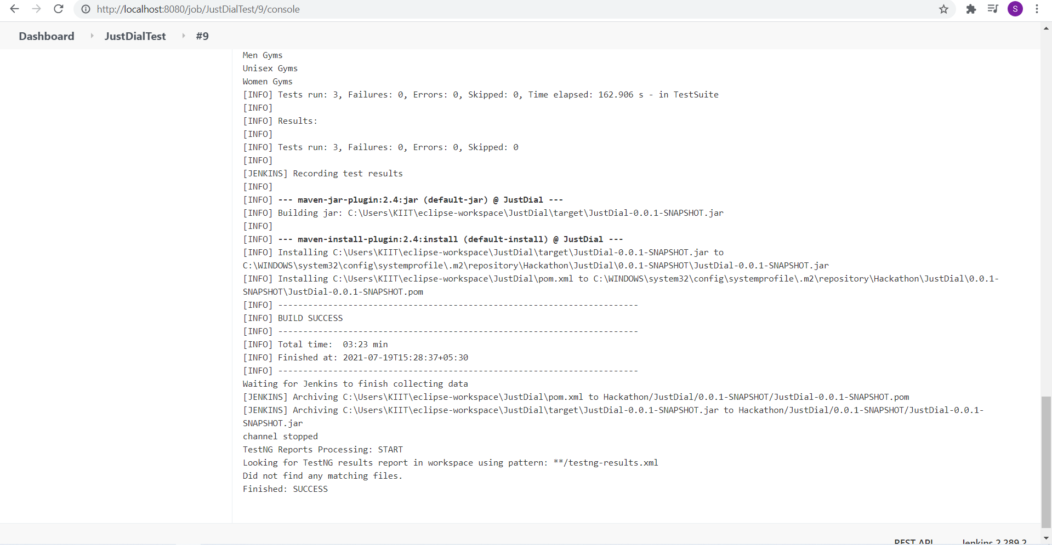

Slide 21
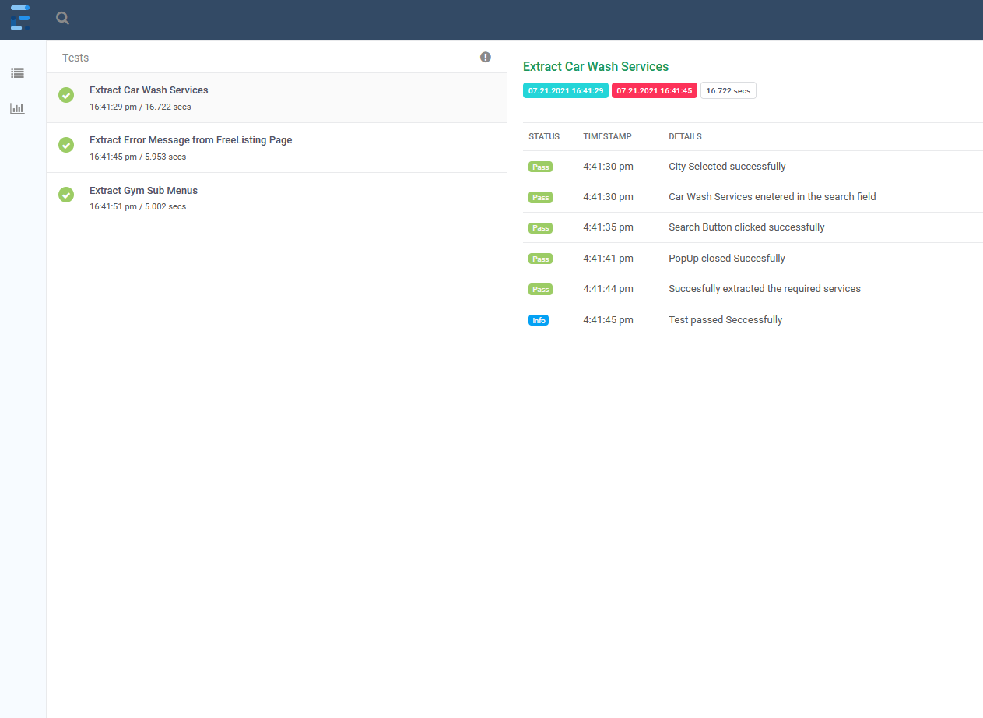
Extent Report:

Slide 22
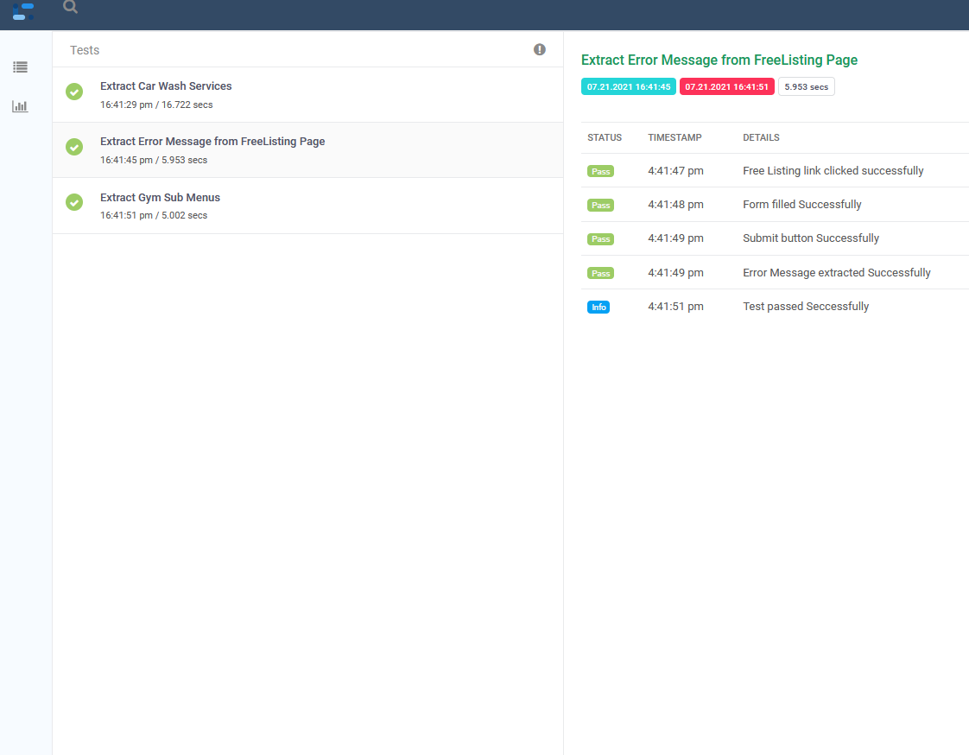

Slide 23
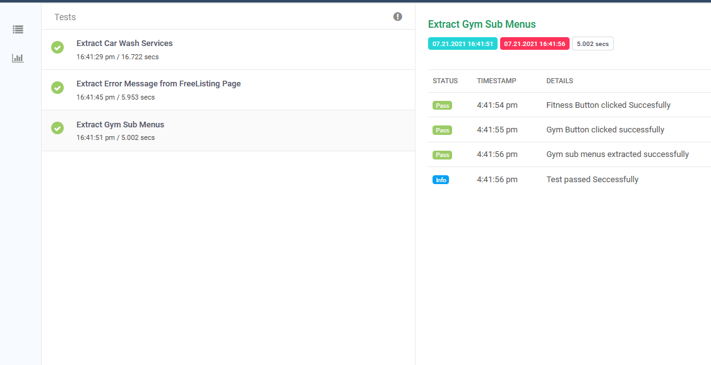

Slide 24
Key Automation Scope:
Handling Alert, search option
Filling form (in different objects in web page)
Capture warning message
Extract menu items & store in collections
Navigating back to home page

Slide 25
Thank you

